Slide 1

BLOCKCHAIN BASED CHAIN OF CUSTODY
Submitted By:-
Sourav Mahapatra.
1902041036.
Sushruta Behera.
1902041051.
Guided By:-
Dr. Sumitra Kisan
COMPUTER SCIENCE AND ENGINEERING
VEER SURENDRA SAI UNIVERSITY OF TECHNOLOGY,BURLA
2022-23

Slide 2
CONTENTS
Introduction
Motivation
Objective
Literature review
Proposed method
Result and discussion
Conclusion and future scope
Reference

Slide 3
INTRODUCTION
From the time of evidence collection until the time of their presenting it in a legal court, evidences may be accessed by multiple parties involved in the investigation.
The Chain of Custody is the process of validating how any kind of evidence can be gathered, tracked and protected on its way to a court of law.
In Blockchain based chain of Custody, block contain information such as hash of evidence and description of evidences are stored in block.
In this method we ensure the data integrity and data traceability.

Slide 4
MOTIVATION
Nowadays, Crimes are increasing at a higher rate and due to improper management of evidence the culprits are not getting punishment.
Due to tempering of evidence or loss of evidence many people are not getting justice and the crimes goes on increasing day by day.
Hence by the help of B-CoC architecture evidence are preserved until the time of presenting it in the court.

Slide 5
OBJECTIVE
The main objective of our project is to ensure that evidence should not be tempered from the time of collection to the time of presenting it in the court.
If evidence get tempered at any owner’s possession then we came to know about the tempered evidence by comparing the newly generated hash with the old one.

Slide 6
LITERATURE REVIEW
Sl.No. | Year | Author Name | Method
1. | 2011 | Azhari SN | DEMF(Digital Evidence Management Framework)
2. | 2018 | Giuliano Giova | AFF(Advanced Forensic Format) and RDF(Resource Description Framework)
3. | 2018 | Marco Casini | B-CoC Architecture.
4. | 2017 | Jasmin Cosic | DCoDeOn (Digital Chain Of Custody Digital Evidence Ontology)
5. | 2019 | Mark Scanlon | RAFT(Remote Acquisition Forensic Technique)

Slide 7
PROPOSED METHOD
USER ENTERS EVIDENCE DETAILS
EVIDENCE
CREATION
TRANSFER
EVIDENCE
REMOVE
EVIDENCE
GET
EVIDENCE

Slide 8
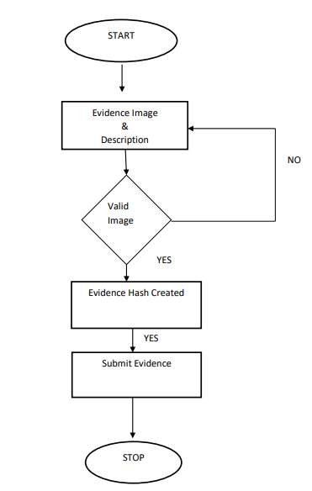
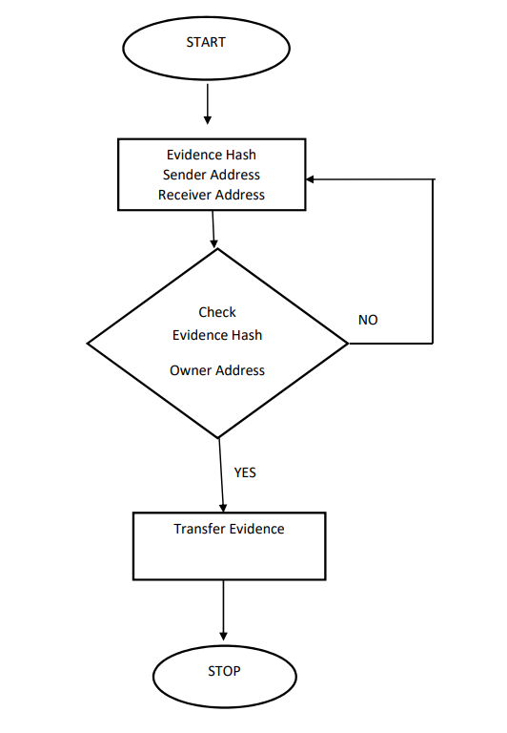
FLOW CHART
EVIDENCE CREATION
EVIDENCE TRANSFER

Slide 9
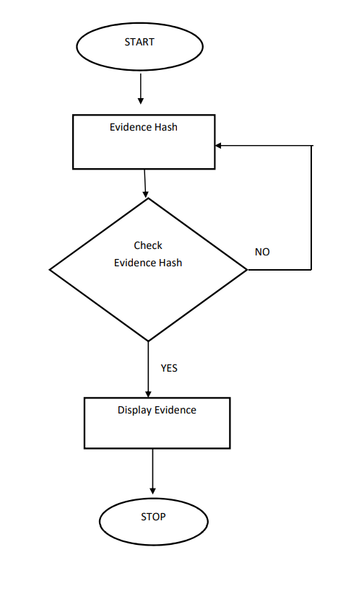
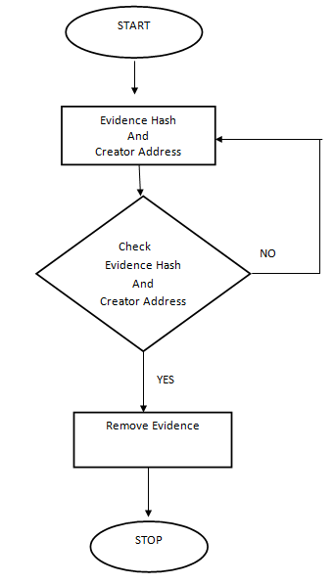
FLOW CHART
GET EVIDENCE
REMOVE EVIDENCE

Slide 10
ALGORITHM
Creation of Evidence( ) :
Input : Evidence images, User Address, Evidence Description
Output:
If (!valid image format)
Evidence creation failed
else
Evidence Created Successfully
Transfer Evidence( ) :
Input: Evidence ID(hash value), Owner Address, Receiver Address
Output:
Calculate the new hash
If (new hash != Evidence ID)
Owner Might have tempered the Evidence
else if(!(Owner Address && Receiver Address))
Something Error has occurred
else
Evidence transferred Successfully

Slide 11
ALGORITHM
Get Evidence( ) :
Input : Evidence ID(hash value), User Address
Output:
If (Evidence ID)
Evidence Details Displayed Successfully
else
Failed to display Evidence Details
Remove Evidence( ) :
Input: Evidence ID(hash value), Creator Address
Output:
If (!(Evidence ID && Creator Address))
Remove Evidence Failed
else
Evidence removed Successfully

Slide 12
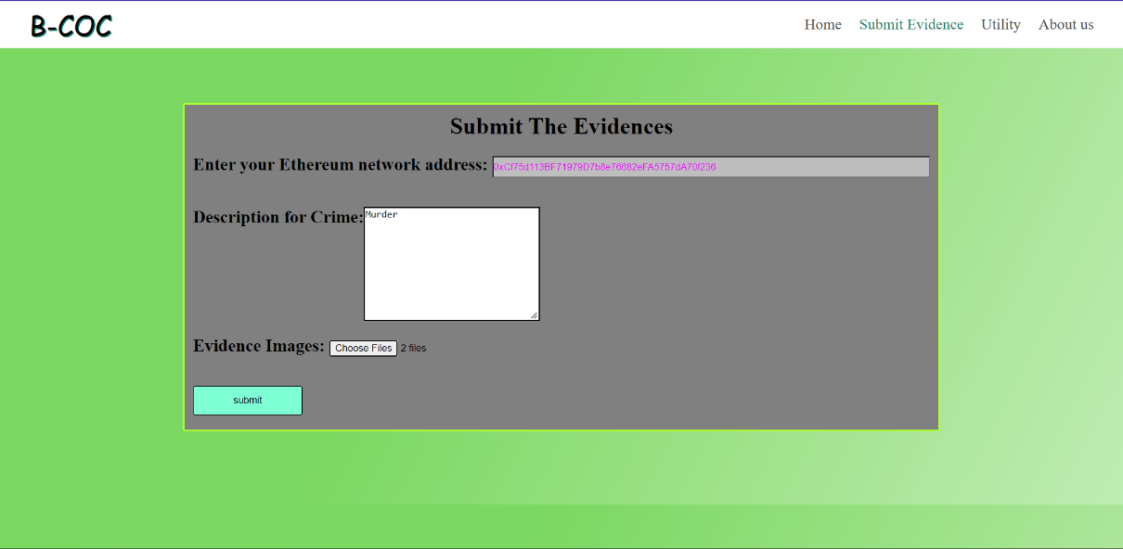
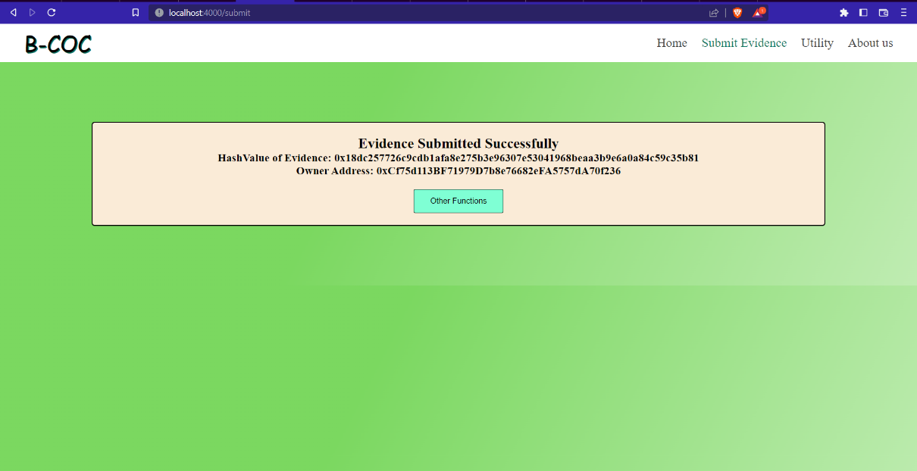
RESULT AND DISCUSSION
Evidence Creation

Slide 13
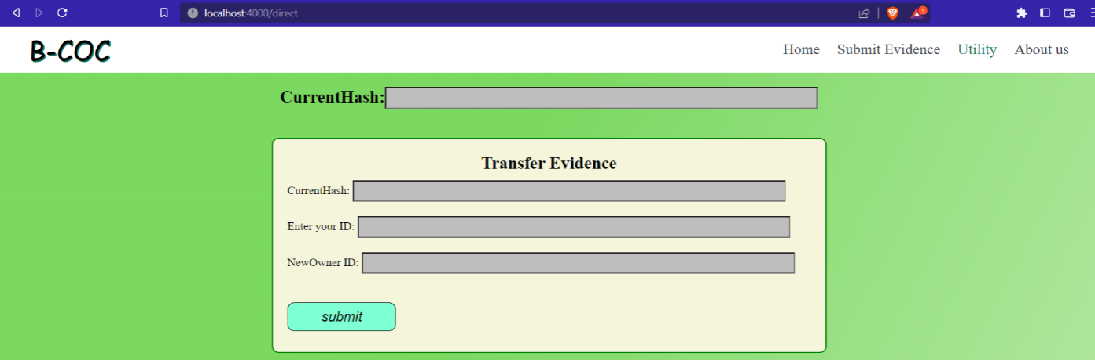
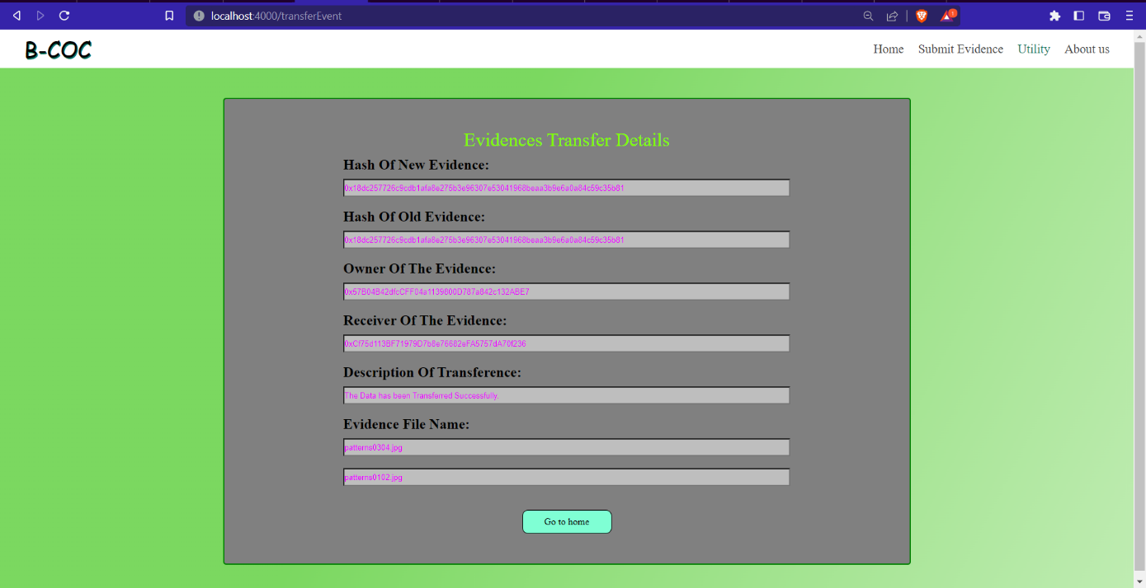
RESULT AND DISCUSSION
Transfer Evidence

Slide 14
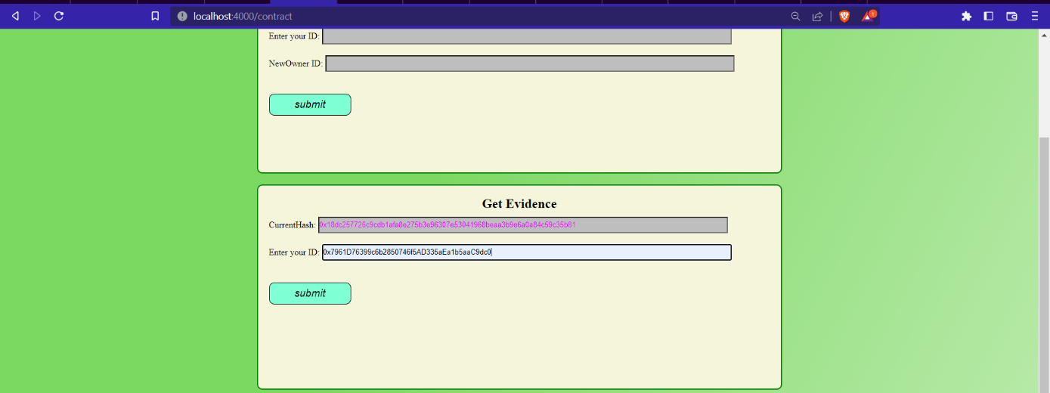
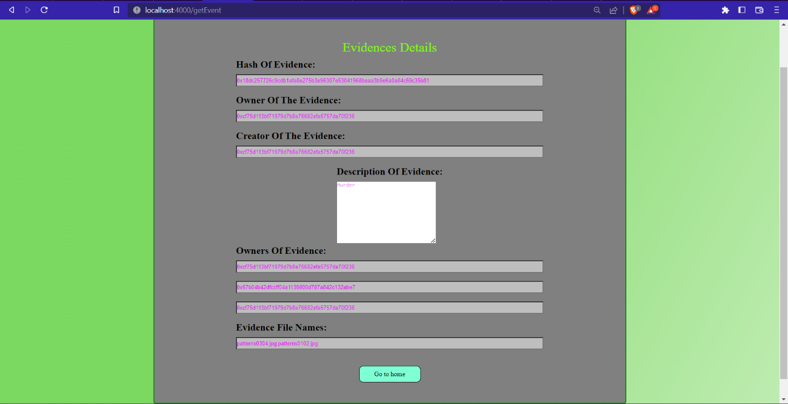
RESULT AND DISCUSSION
Get Evidence

Slide 15

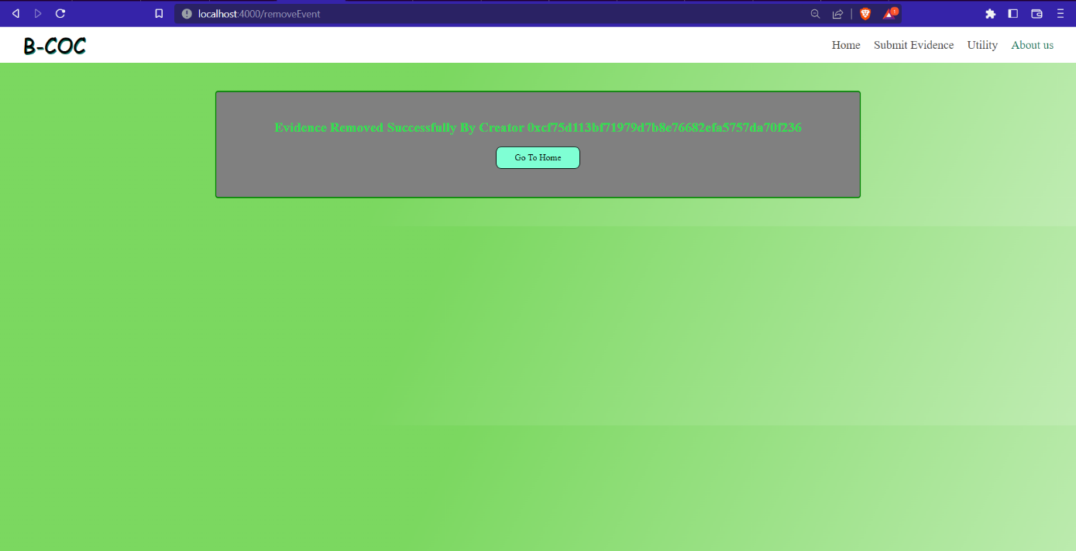
RESULT AND DISCUSSION
Remove Evidence

Slide 16
CONCLUSION AND FUTURE SCOPE
We have represented B-CoC Architecture to show different process need to be followed in order to deal with evidence.
We implemented different types of functions right from collection of evidence to present it in court
We ensure that evidence would not be tempered as it passes from person to person.
In our future work we should be able to know which particular evidence had been modified out of group of evidences and by means of what tempering technique.

Slide 17
REFERENCES
[1] Giova, G. (2011). Improving chain of custody in forensic investigation of electronic digital systems. International Journal of Computer Science and Network Security, 11(1), 1-9.
[2] Carrier B. Defining digital forensic examination and analysis tools using abstraction layers. International Journal of digital evidence. 2003 Jan;1(4):1-2.
[3] Castro, Miguel, and Barbara Liskov. "Practical byzantine fault tolerance." In OsDI, vol. 99, no. 1999, pp. 173-186. 1999.
[4] Brinson, Ashley, Abigail Robinson, and Marcus Rogers. "A cyber forensics ontology: Creating a new approach to studying cyber forensics." digital investigation 3 (2006): 37-43.
[5] Ćosić, Jasmin, and Miroslav Bača. "(Im) proving chain of custody and digital evidence integrity with time stamp." In The 33rd International Convention MIPRO, pp. 1226-1230. IEEE, 2010.

Slide 18
THANK YOU

